Slide 1

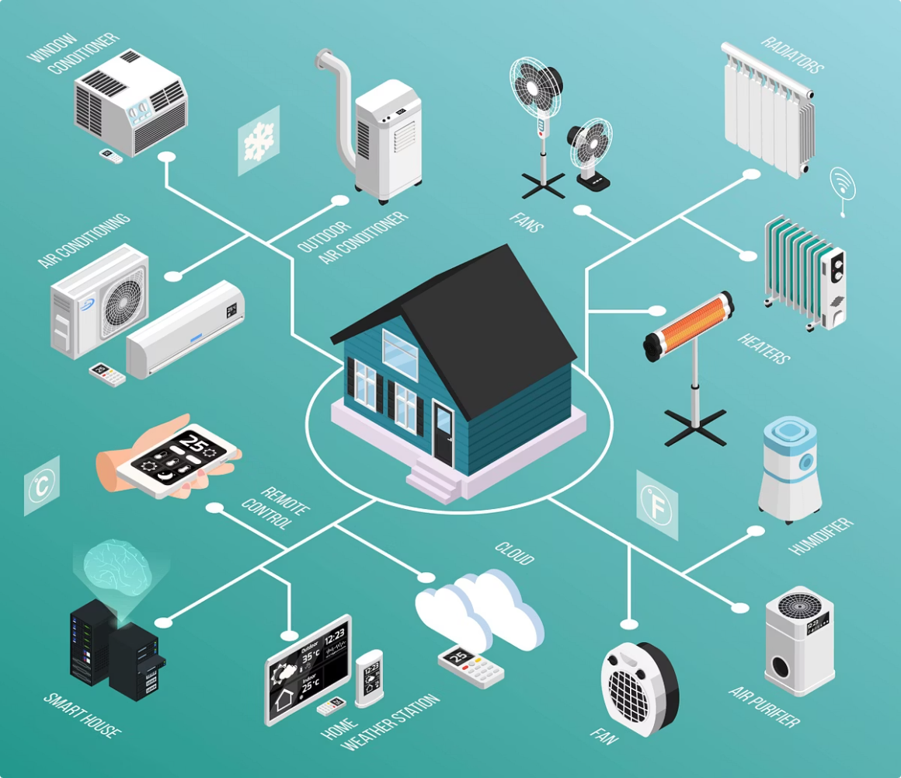
IoT-Based Smart Home Automation and Surveillance System
Presented by: Vedant Mahadik
Instructor: Prof. Bidhan Pramanick | Submission Date: 12/05/2025

Slide 2
Introduction
Integrated IoT system combines multiple smart home functions.
Plant watering automation using soil moisture sensors and Arduino.
Environmental monitoring with gas, flame, and temperature sensors.
Smart surveillance with ESP32-CAM and real-time face detection.
Control through Blynk mobile app, Alexa voice, Flask backend, and cloud services.

Slide 3
Project Objectives
Automate and manual control plant irrigation and water tank monitoring
Continuously monitor environment parameters safely
Enable remote and voice control via mobile and Alexa
Implement smart surveillance with face detection
Ensure safety through intelligent alert systems.

Slide 4
System Overview
Plant Watering
Environment Monitoring
Surveillance
Automated irrigation based on soil moisture set thresholds
Voice controlled motor and valves
Remote access for user control via blynk mobile app
Real time notifications about water pump tank level to prevent dry running
Gas and Flame sensing for safety
Environmental sensing through DHT11 sensor
Voice and remote accessed manual control of home appliances
Alerts if gas and flame sensor exceeds thresholds
Real-time footage
Human Face detection (using MediaPipe)
Both local and cloud storage
Self hosted servers

Slide 5
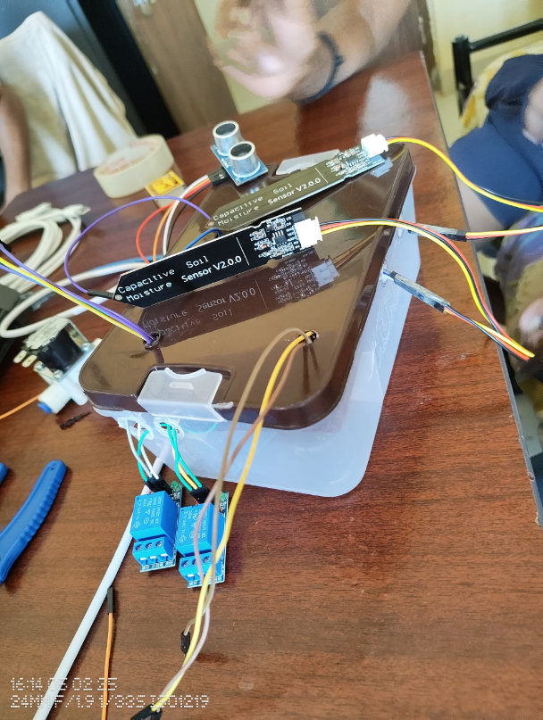
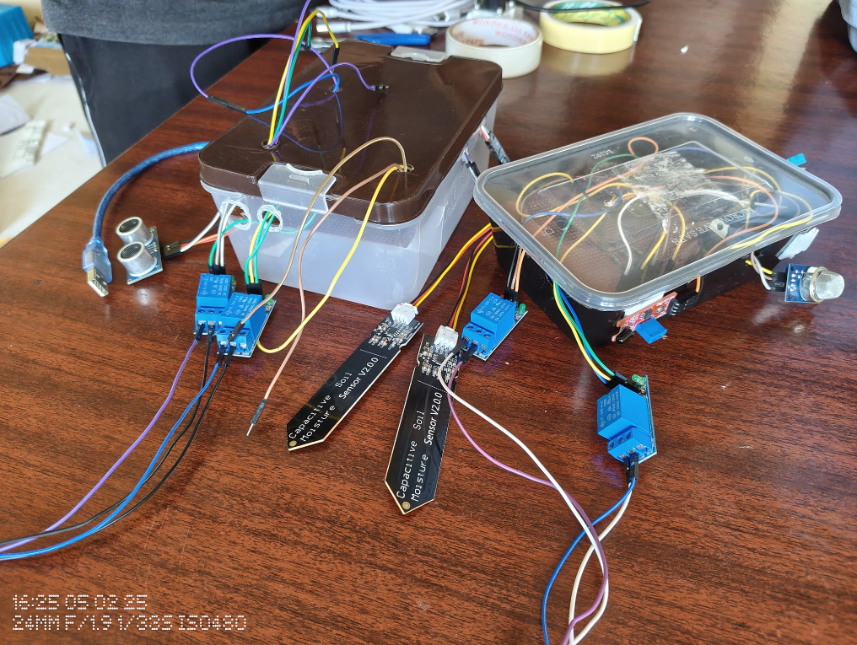
System 1: Smart Plant Watering System
Hardware Components
Key Functions
Soil moisture sensors, Temperature and Ultrasonic Sensor
Automated and manual irrigation (By voice Command and Blynk app)
Arduino UNO and ESP8266
Water tank level monitoring
Relays, pump, solenoid valve
Blynk app notifications

Slide 6
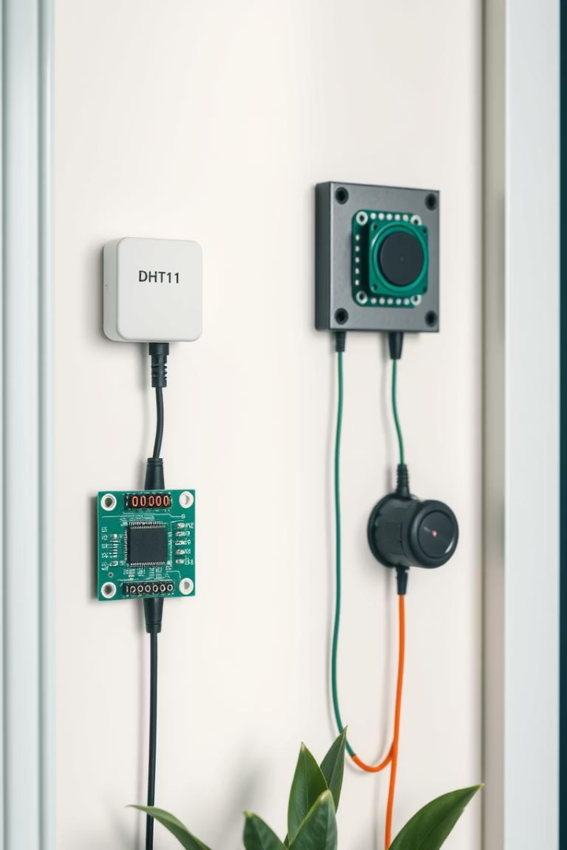
System 2: Environment Monitoring
Sensors
Control
DHT11, MQ-2 gas, and flame sensors for parameter detection
Fan and light control via relays with Voice command and Blynk app
Access & Alerts
Blynk mobile app and Alexa voice commands with flame/gas alerts

Slide 7
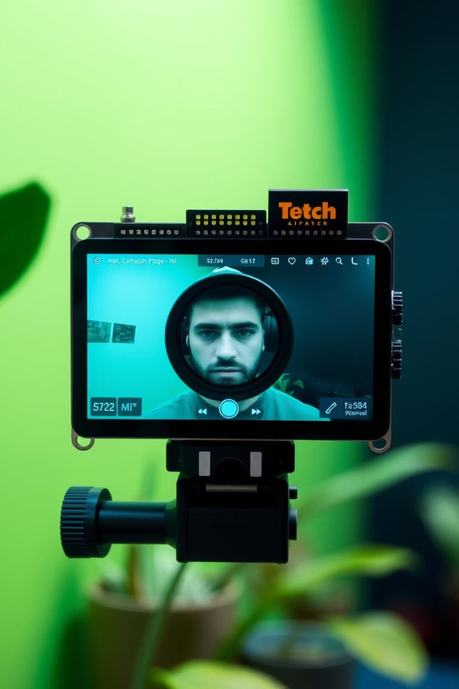



System 3: Smart Surveillance
Local IP Streaming
Live video from ESP32-CAM on same local network
Remote Camera 1
Flask server with MediaPipe for face detection and SD card for storage if human face detected
Remote accessed footage streaming through web page
Remote Camera 2
Flask integrated with Cloudinary cloud storage if human face detected

Slide 8

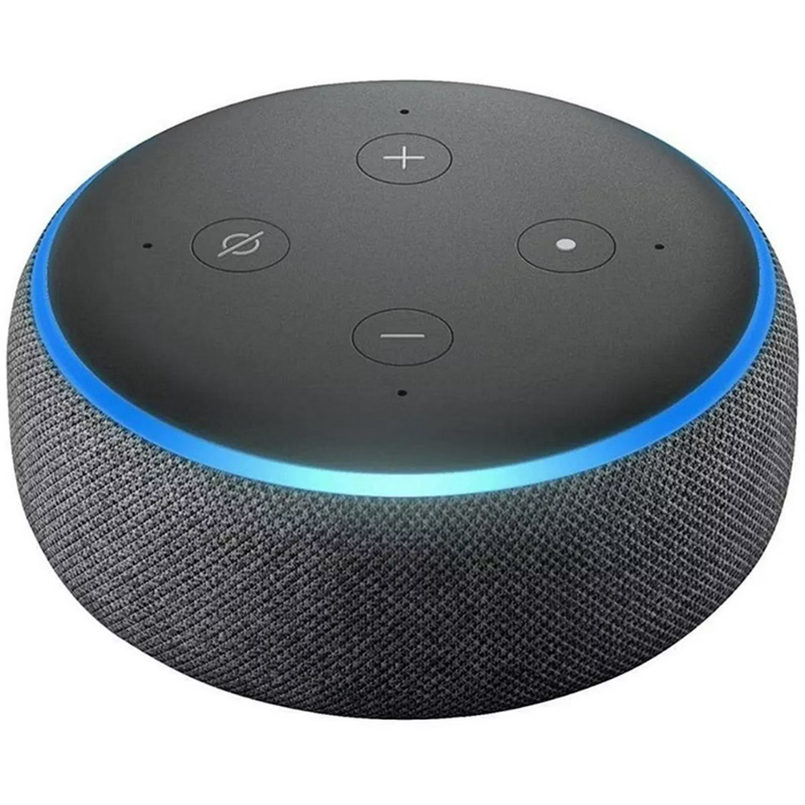
Voice Control Integration
Platform Used
Devices Controlled
Sinric Pro links Alexa with smart home devices
Relays, fans, pumps, and lights
User Interaction
Hands-free voice commands for automation

Slide 9

Blynk App Integration
Platform
Blynk IoT platform with drag-and-drop UI builder
Dashboard
Customizable panels displaying live data and alerts
Remote Control
Manage devices and users anywhere, anytime
Compatibility
Cross-platform support for iOS and Android

Slide 10
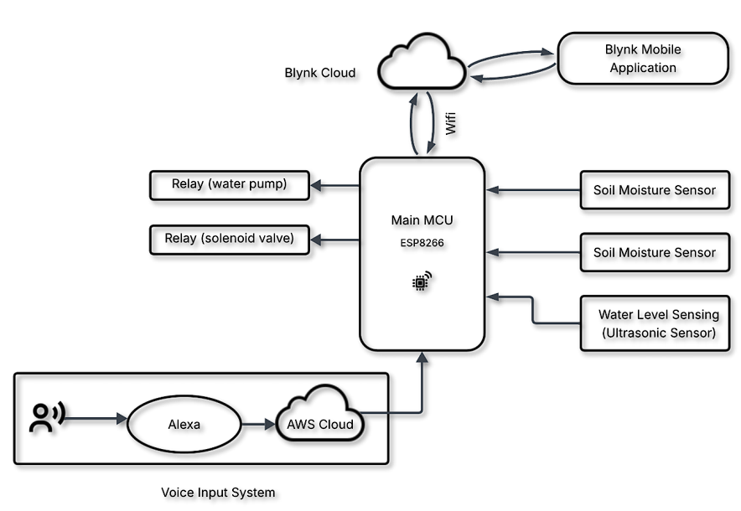
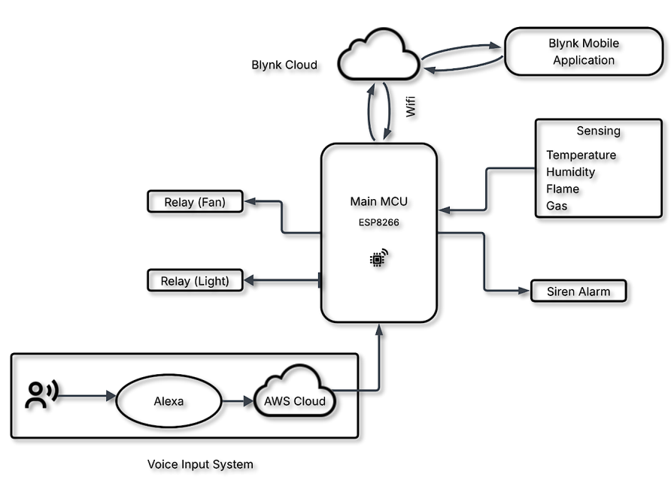
Block Diagrams
Smart Plant Watering System
Home Automation and Environment System

Slide 11
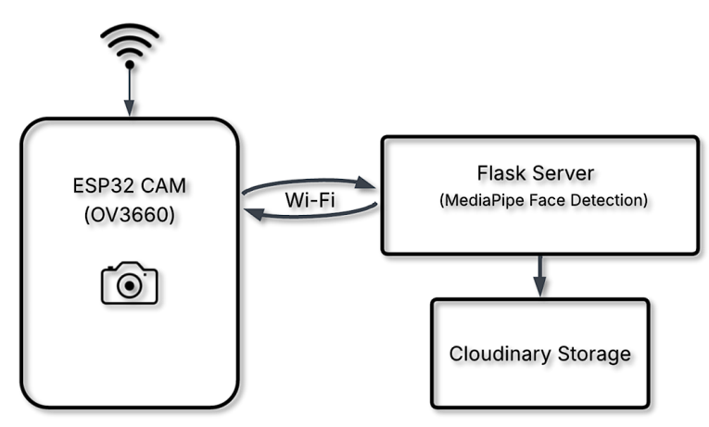
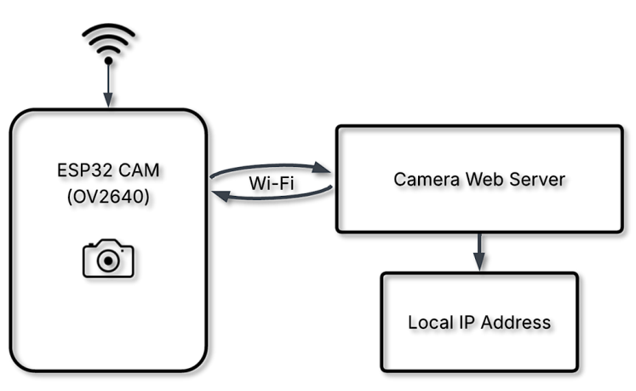
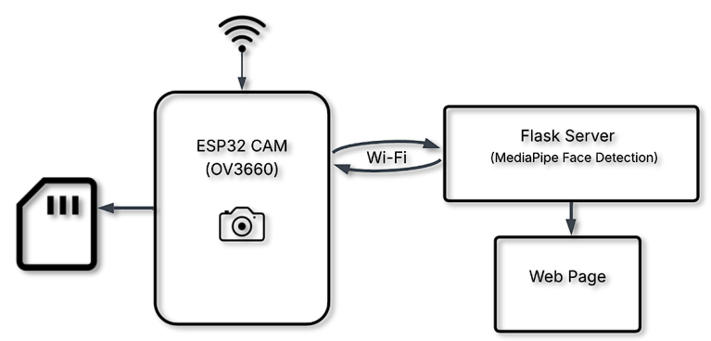
Remote Camera 2 (Flask + MediaPipe + Cloudinary)
Local IP Camera 1
Remote Camera 1 (Flask + MediaPipe + SD Card)

Slide 12
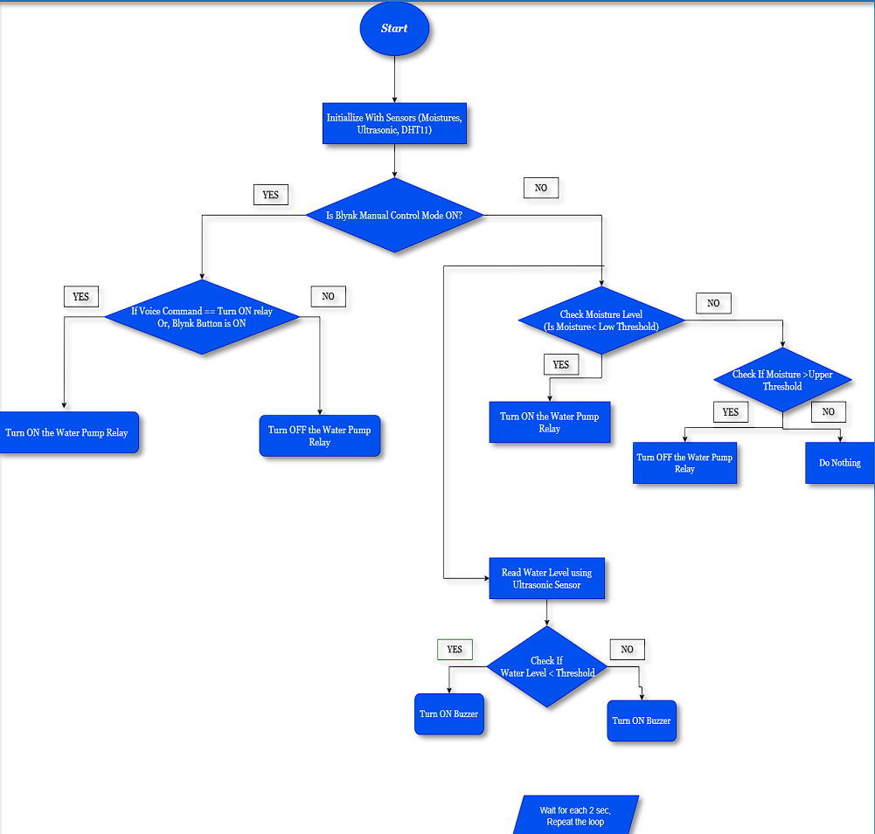
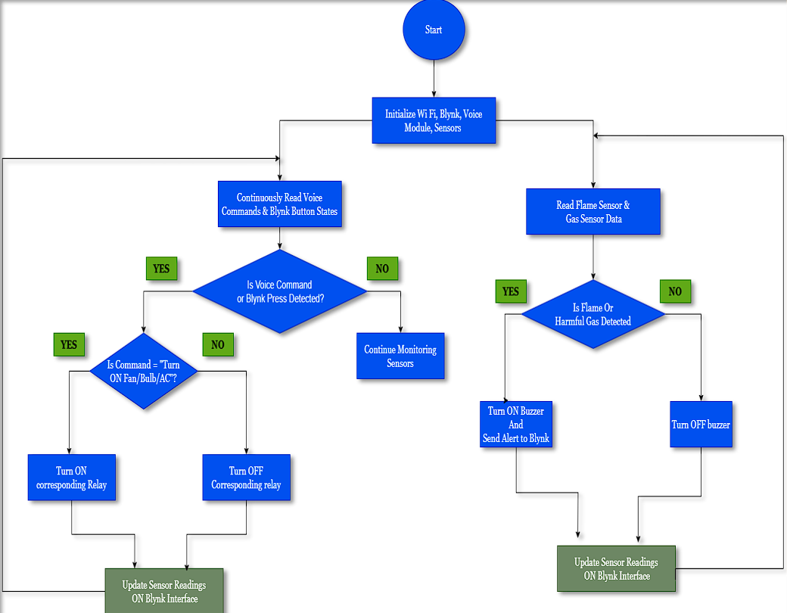
Flowcharts
Smart Plant Watering System
Home Automation and Environment System

Slide 13
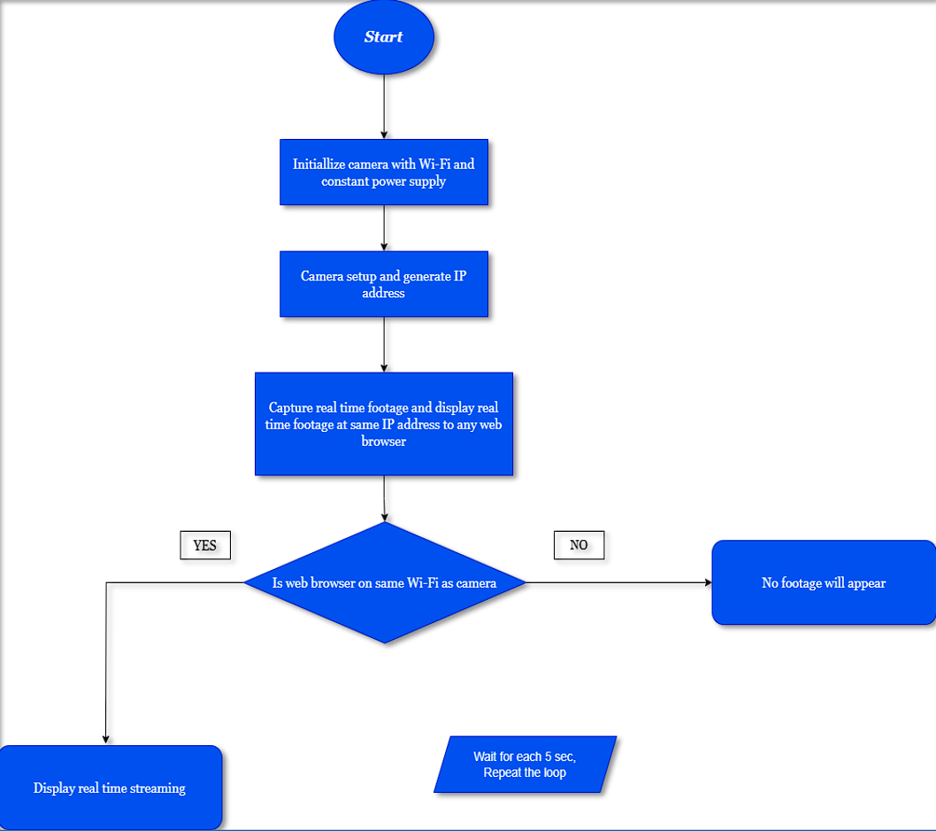
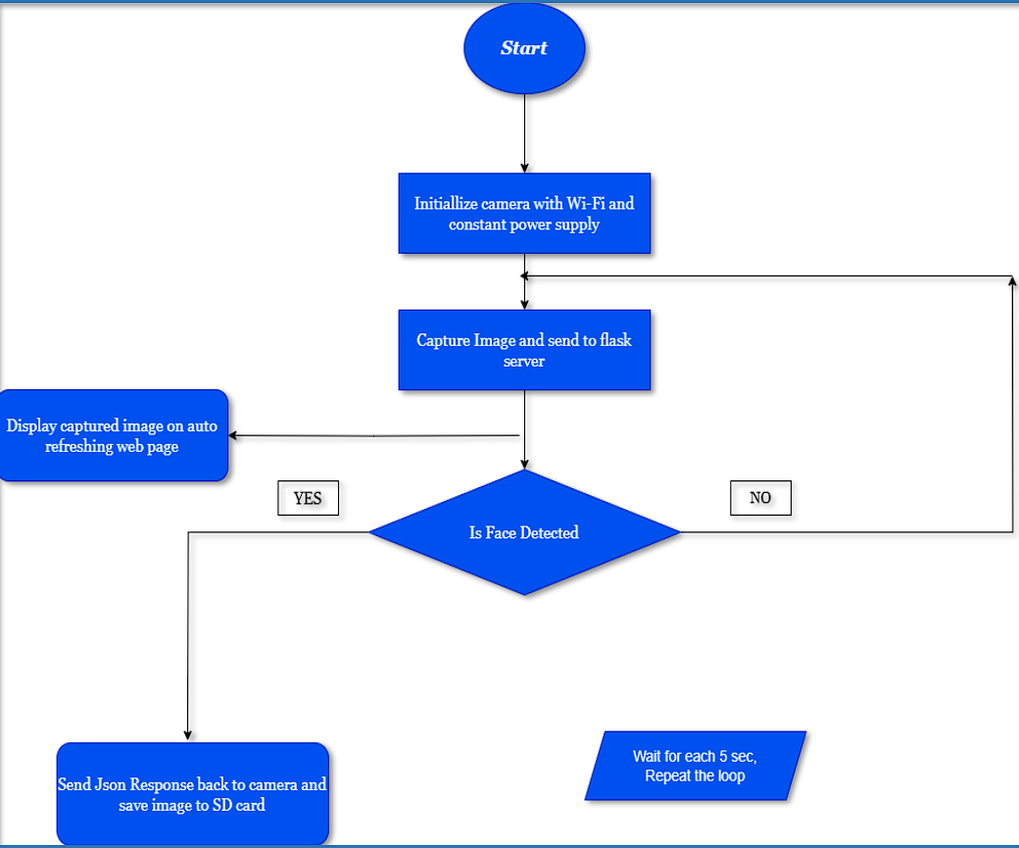
Local IP Camera 1
Remote Camera 1 (Flask + MediaPipe + SD Card)
Remote Camera 2 (Flask + MediaPipe + Cloudinary)

Slide 14
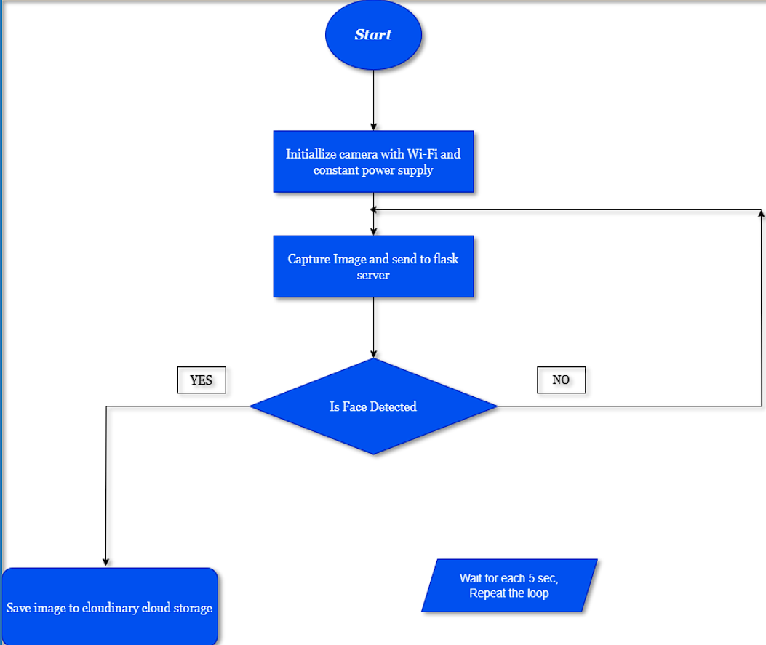
Remote Camera 2 (Flask + MediaPipe + Cloudinary)

Slide 15
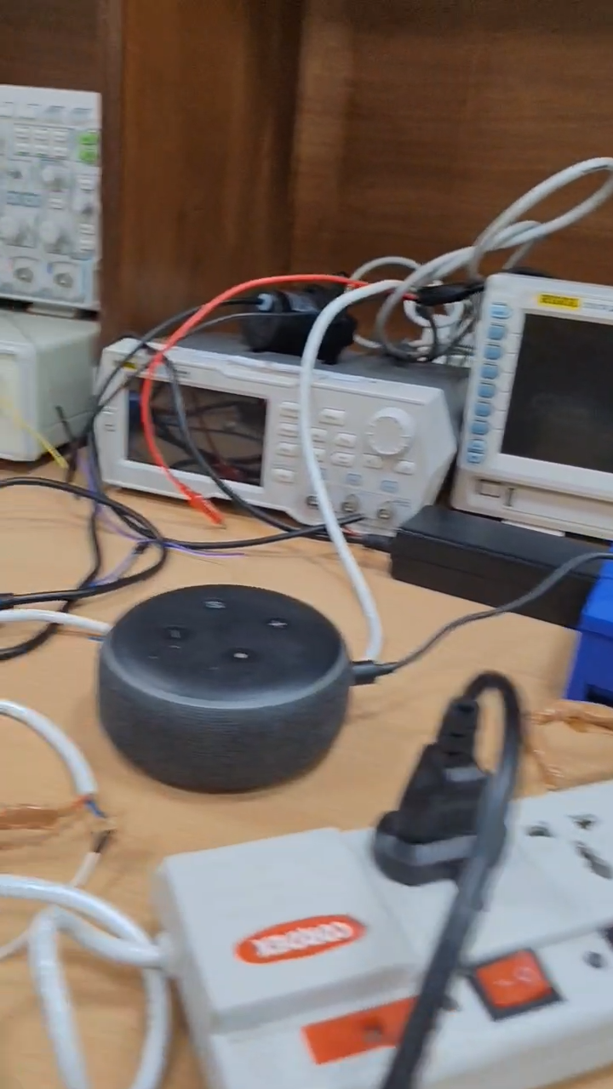

Results and Discussion
Responsiveness
Fast reaction times from sensors and control modules
Reliability
Accurate sensing and consistent alert and notification generation
Performance
Real-time monitoring and efficient voice-command execution
Integration
Seamless operation combining hardware and cloud services

Slide 16

Thank You!
We sincerely thank you for your time and attention.
This project represents our vision for a smarter, safer, and more connected home.
We're excited about the future of IoT, AI, and automation—and grateful for the opportunity to share our work.

